Slide 1

Lab 4 : Array
Data Structure
Dr. Pradyuman U. Jadeja
Computer Engineering Department
pradyuman.jadeja@darshan.ac.in
+91 9879461848

Slide 2
Program - 24
Write a program to insert a number at a given location in an array.
INPUT:
Take total elements ('size'/'n') from user
Take position (POS) where to insert
Take value (VAL) to insert
METHODOLOGY INVOLVED:
Declare a variable 'size' of data type int, take it from user
Declare an array having total capacity of 'size’
Take position (POS) and value (VAL) from user
Shift elements right from end to POS: A[I+1] ← A[I]
Place new value: A[POS] ← VAL, update size: N ← N + 1
OUTPUT:
Display the updated array after insertion

Slide 3
Program - 24
Write a program to insert a number at a given location in an array.
// Read the array N-1
Algorithm
1. [Validate the given position]
IF POS < 1 OR POS > N+1
THEN PRINT “INVALID POS” Return
2. [Shift elements one position to the right from the end to POS]
SET I ← N
REPEAT WHILE I >= POS
A[I+1] ← A[I]
I ← I – 1
END REPEAT
3. [Place the new value at the desired position]
A[POS] ← VAL
4. [Update array size and display result]
N ← N + 1
PRINT A[1..N]

Slide 4
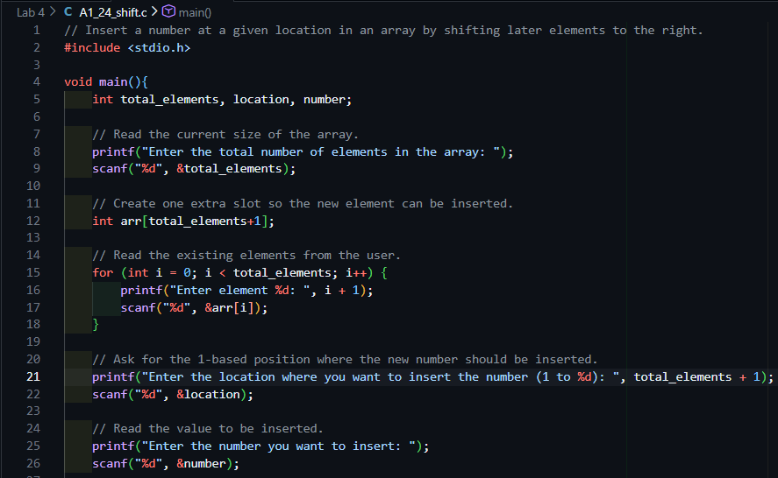
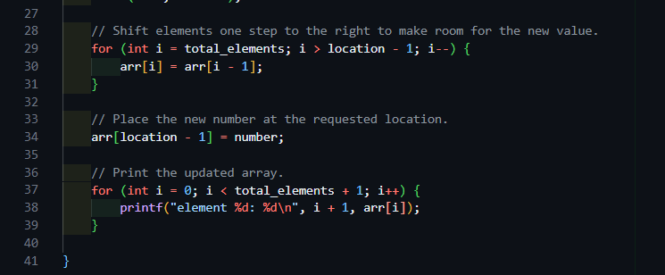
Program - 24
C Function

Slide 5
Program - 25
Write a program to delete a number from a given location in an array.
INPUT:
Take total elements ('size'/'n') from user
Take position (POS) to delete from
METHODOLOGY INVOLVED:
Declare a variable 'size' of data type int, take it from user
Declare an array having total capacity of 'size’
Validate: if POS < 1 OR POS > N, print "INVALID POS" and stop.
Shift elements left from POS: A[I] ← A[I+1]
Update size: N ← N − 1, then display A[1..N]
OUTPUT:
Display the updated array after deletion

Slide 6
Program - 25
Write a program to delete a number from a given location in an array.
Algorithm
1. [Validate the given position]
IF POS < 1 OR POS > N+1
THEN PRINT “INVALID POS” Return
2. [Shift elements left from POS+1 to end, overwriting deleted element]
SET I ← POS
REPEAT WHILE I < N
A[I] ← A[I+1]
I ← I – 1
END REPEAT
3. [Update array size and display result]
N ← N - 1
PRINT A[1..N]

Slide 7
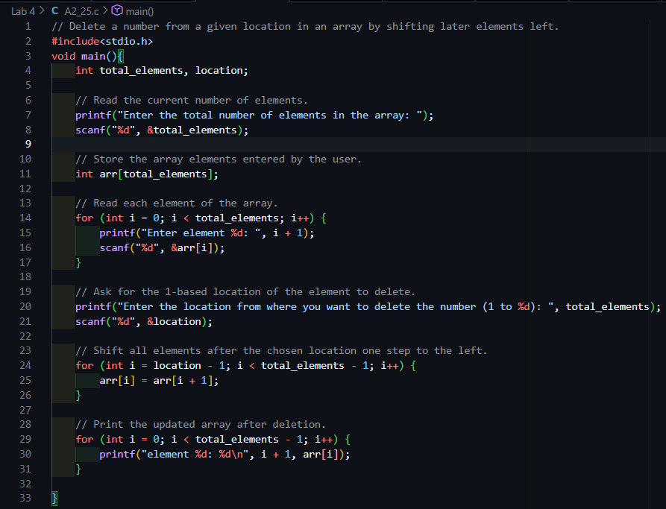
Program - 25
C Function

Slide 8
Program - 26
Write a program to insert a number in an array sorted in ascending order.
INPUT:
Take sorted array elements (size N) from user
Take value (VAL) to insert
METHODOLOGY INVOLVED:
Declare a variable 'size' of data type int, take it from user
Declare a sorted array of capacity 'size’
Scan from end, shift right while A[I] > VAL: A[I+1] ← A[I]
Insert at correct position: A[I+1] ← VAL
Update size: N ← N + 1, then display sorted A[1..N]
OUTPUT:
Display the sorted array after insertion

Slide 9
Program - 26
Write a program to insert a number in an array that is already sorted in an ascending order.
Algorithm
1. [Scan from the end to find correct insertion position]
SET I ← N
REPEAT WHILE I >= 1 AND A[I] > VAL
A[I+1] ← A[I] / shift right /
I ← I – 1
END REPEAT
2. [Insert VAL at its correct position to maintain sorted order]
A[I+1] ← VAL
3. [Update size and print sorted array]
N ← N + 1
PRINT A[1..N]

Slide 10
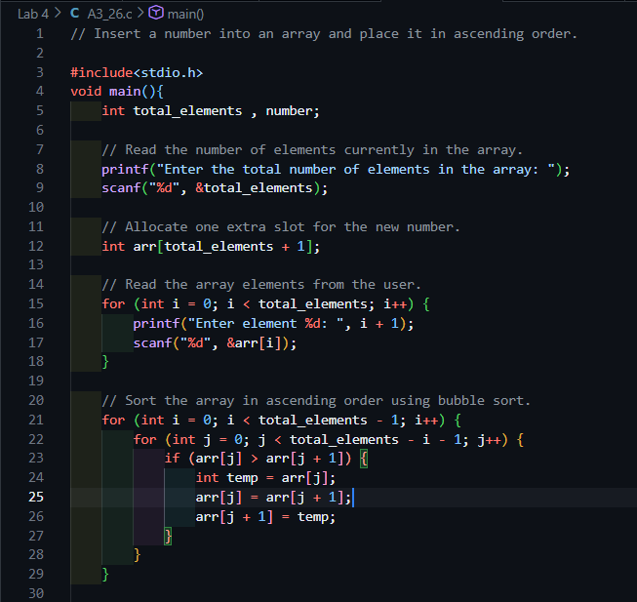
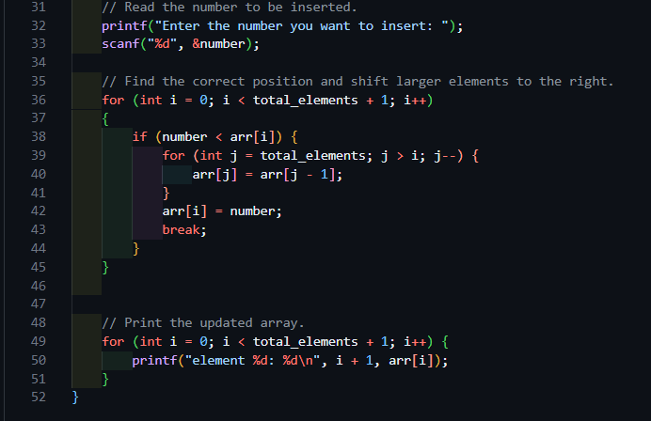
Program#26
C Function

Slide 11
Program - 27
Write a program to delete a number from an array sorted in ascending order.
INPUT:
Take sorted array elements (size N) from user
Take value (VAL) to delete
METHODOLOGY INVOLVED:
Declare a variable 'size' of data type int, take it from user
Linear search for VAL; record position POS (initialize POS ← −1)
If POS = −1, print "Value not found" and stop
Shift elements left: A[I] ← A[I+1]
Update size: N ← N − 1, then display A[1..N]
OUTPUT:
Display the sorted array after deletion

Slide 12
Program - 27
Write a program to delete a number from an array that is already sorted in an ascending order.
Algorithm
1. [Search for VAL using linear scan]
SET I ← 1, POS ← -1
REPEAT WHILE I <= N
IF A[I] = VAL
THEN POS ← I
BREAK
I ← I + 1
END REPEAT
2. [If not found, report error and stop]
IF POS = -1
THEN PRINT "Value not found"
EXIT
3. [Shift elements left from POS to fill the gap]
SET I ← POS
REPEAT WHILE I < N
A[I] ← A[I+1]
I ← I + 1
END REPEAT
4. [Decrease size and display result]
N ← N - 1PRINT A[1..N]

Slide 13
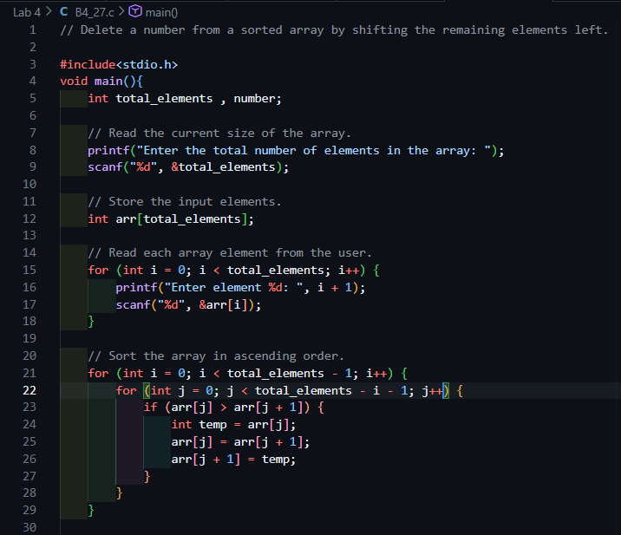
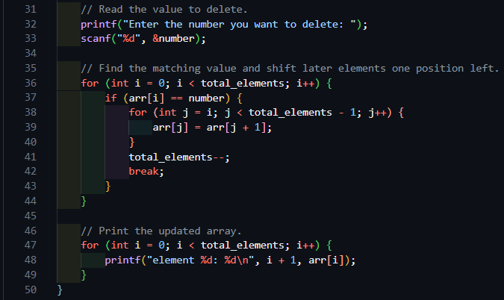
Program#27
C Function

Slide 14
Program - 28
Write a program to delete duplicate numbers from an array.
INPUT:
Take total elements ('size'/'n') from user
METHODOLOGY INVOLVED:
Outer loop: pick each element A[I] as reference (I = 0 to N−1)
Inner loop: compare A[I] with A[J] after it (J = I+1 to N−1)
If A[I] = A[J]: shift elements left from J, decrease N
Repeat until all duplicates removed, then display A[1..N]
OUTPUT:
Display array with all duplicates removed

Slide 15
Program - 28
Write a program to delete duplicate numbers from an array.
Algorithm
1. [Outer loop — pick each element as a reference]
SET I ← 1
REPEAT WHILE I <= N
2. [Inner loop — compare with all elements after I]
SET J ← I + 1
REPEAT WHILE J <= N
IF A[I] = A[J] THEN
/ duplicate found /
SET K ← J
REPEAT WHILE K < N
A[K] ← A[K+1]
/ shift left /
K ← K + 1
END REPEAT
N ← N - 1 / reduce size /
ELSE
J ← J + 1
END IF
END REPEAT
I ← I + 1
END REPEAT
3. [Print array with all duplicates removed]
PRINT A[1..N]

Slide 16
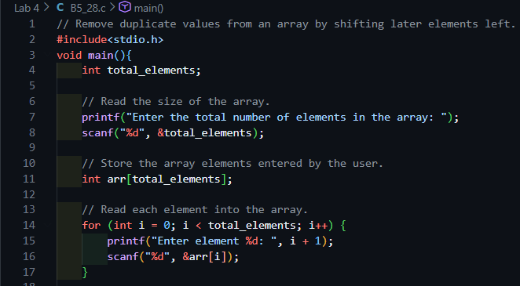
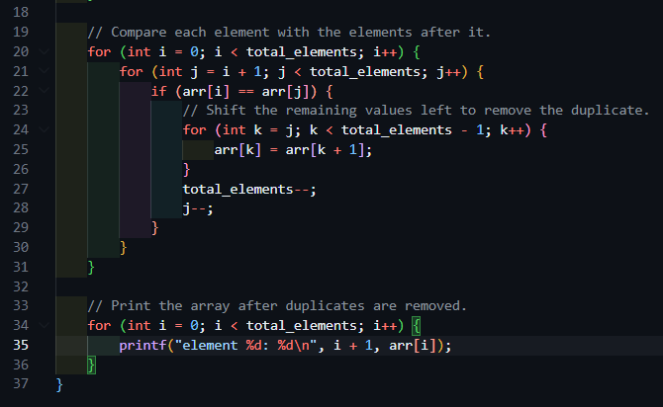
Program#28
C Function

Slide 17
Program - 29
Write a program to merge two unsorted arrays.
INPUT:
Take first array A of size M from user
Take second array B of size N from user
METHODOLOGY INVOLVED:
Declare result array C of size M + N
Copy A into C: C[I] ← A[I] for I = 0 to M−1
Append B after A: C[M+J] ← B[J] for J = 0 to N−1
Display C[0..(M+N−1)]
OUTPUT:
Display merged array C of size M + N

Slide 18
Program#29
Write a program to merge two unsorted arrays.
Algorithm
1. [Declare result array C of size M+N]
DECLARE C[1..(M+N)]
2. [Copy all elements of array A into C]
SET I ← 1
REPEAT WHILE I <= M
C[I] ← A[I]
I ← I + 1
END REPEAT
3. [Append all elements of array
B after A's elements in C]
SET J ← 1
REPEAT WHILE J <= N
C[M+J] ← B[J]
J ← J + 1
END REPEAT
4. [Print merged array C of size M+N]
PRINT C[1..(M+N)]

Slide 19
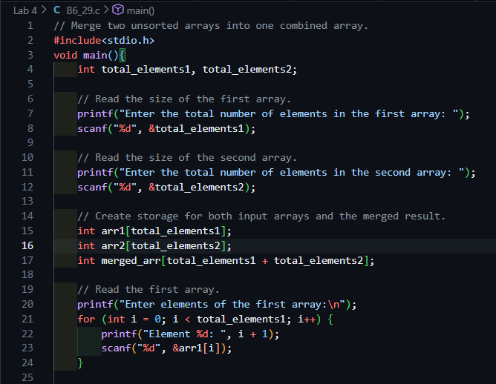
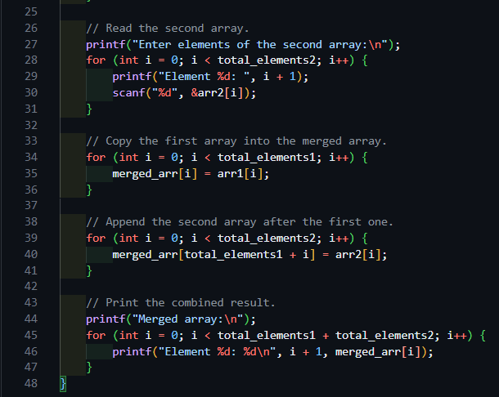
Program#29
C Function

Slide 20
Program - 30
Write a program to replace lowercase characters by uppercase & vice-versa in a user specified string.
INPUT:
Take string (STR) from user
METHODOLOGY INVOLVED:
Find length N of string
Scan each character CH one by one (I = 0 to N−1)
If CH is lowercase (a–z): convert to uppercase (ASCII − 32)
If CH is uppercase (A–Z): convert to lowercase (ASCII + 32)
Display the final swapped string
OUTPUT:
Display string with cases swapped

Slide 21
Program#30
WAP to replace lowercase characters by uppercase & vice-versa in a user specified string.
Algorithm
[Find length of string and initialize result]
SET N ← LENGTH(STR)SET
RESULT ← ""
2. [Scan each character one by one]
SET I ← 1
REPEAT WHILE I <= N
SET CH ← STR[I]
3. [If character is lowercase, convert to uppercase]
IF CH >= 'a' AND CH <= 'z’
THEN CH ← TOUPPER(CH)
/ ASCII - 32 /
4. [Else if uppercase, convert to lowercase]
ELSE IF CH >= 'A' AND CH <= ‘Z’
THEN CH ← TOLOWER(CH)/ ASCII + 32 /
END IF 5. [Append converted character to result string]
RESULT ← RESULT + CH
I ← I + 1
END REPEAT
6. [Print the final converted string]
PRINT RESULT

Slide 22
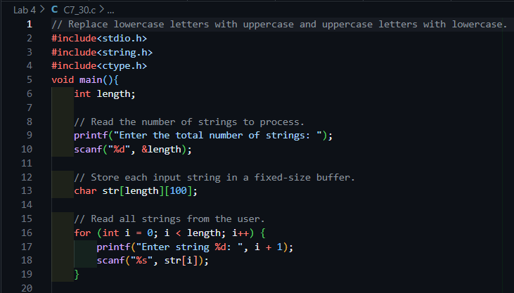
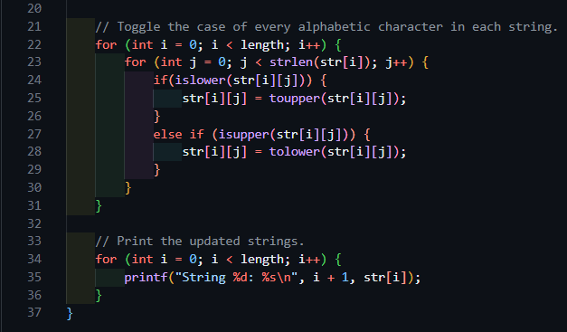
Program#30
C Function

Slide 23
Data Structure
Dr. Pradyuman U. Jadeja
Computer Engineering Department
pradyuman.jadeja@darshan.ac.in
+91 9879461848

